Slide 1
Key Application Performance Metrics

Slide 2
1. User Satisfaction
The application performance index, or Apdex score, has become an industry standard for tracking the relative performance of an application.
It works by specifying a goal for how long a specific web request or transaction should take.
Those transactions are then bucketed into satisfied (fast), tolerating (sluggish), too slow, and failed requests. A simple math formula is then applied to provide a score from 0 to 1.

Slide 3

1. User Satisfaction

Slide 4
2. Average Response Time
Let me start by saying that averages suck. I highly recommend using the aforementioned user satisfaction Apdex scores as a preferred way to track overall performance. That said, averages are still a useful application performance metric

Slide 5
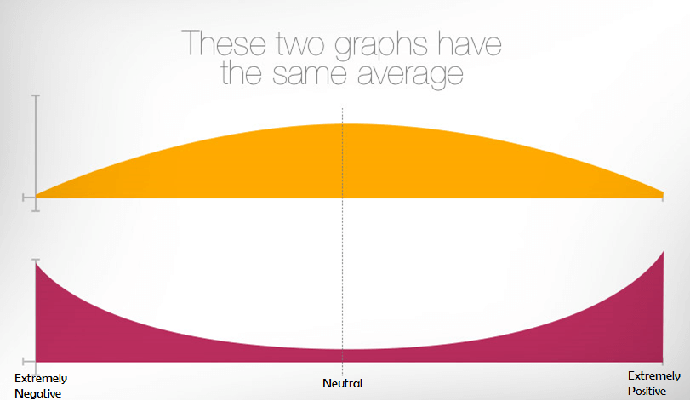
2. Average Response Time
https://stackify.com/15-metrics-for-devops-success/

Slide 6
3. Error Rates
The last thing you want your users to see are errors. Monitoring error rates is a critical application performance metric.
There are potentially 3 different ways to track application errors:
HTTP Error % – Number of web requests that ended in an error
Logged Exceptions – Number of unhandled and logged errors from your application
Thrown Exceptions – Number of all exceptions that have been thrown
It is common to see thousands of exceptions being thrown and ignored within an application. Hidden application exceptions can cause a lot of performance problems.
https://stackify.com/retrace-error-monitoring/

Slide 7
4. Count of Application Instances
If your application scales up and down in the cloud, it is important to know how many server/application instances you have running. Auto-scaling can help ensure your application scales to meet demand and saves you money during off-peak times. This also creates some unique monitoring challenges.
For example, if your application automatically scales up based on CPU usage, you may never see your CPU get high. You would instead see the number of server instances get high. (Not to mention your hosting bill going way up!)

Slide 8
5. Request Rate
Understanding how much traffic your application receives will impact the success of your application. Potentially all other application performance metrics are affected by increases or decreases in traffic.
Request rates can be useful to correlate to other application performance metrics to understand the dynamics of how your application scales.

Slide 9
5. Request Rate
Monitoring the request rate can also be good to watch for spikes or even inactivity. If you have a busy API that suddenly gets no traffic at all, that could be a really bad thing to watch out for.
A similar but slightly different metric to track is the number of concurrent users. This is another interesting metric to track to see how it correlates.

Slide 10
6. Application & Server CPU
If the CPU usage on your server is extremely high, you can guarantee you will have application performance problems. Monitoring the CPU usage of your server and applications is a basic and critical metric.
Virtually all server and application monitoring tools can track your CPU usage and provide monitoring alerts. It is important to track them per server but also as an aggregate across all the individually deployed instances of your application.

Slide 11
6. Application & Server CPU
https://stackify.com/application-monitoring/

Slide 12
7. Application Availability
Monitoring and measuring if your application is online and available is a key metric you should be tracking. Most companies use this as a way to measure uptime for service level agreements (SLA).
If you have a web application, the easiest way to monitor application availability is via a simple scheduled HTTP check.
Retrace can run these types of HTTP “ping” checks every minute for you. It can monitor response times, status codes, and even look for specific content on the page.

Slide 13
8. Garbage Collection
If your application is written in .NET, C#, or other programming languages that use garbage collection, you are probably aware of the performance problems that can arise from it.
When garbage collection occurs, it can cause your process to suspend and can use a lot of CPU.

Slide 14
8. Garbage Collection
Garbage collection metrics may not be one of the first things you think about key application performance metrics. It can be a hidden performance problem that is always a good idea to keep an eye on.
For .NET, you can monitor this via the Performance Counter of “% GC Time”. Java has similar capabilities via JMX metrics. Retrace can monitor these via its application metrics capabilities

Slide 15
Summary
Application performance measurement is necessary for all types of applications. Depending on your type of application, there could be many other monitoring needs.
Retrace can help you monitor a broad range of web application performance metrics. Retrace collects critical metrics about your applications, servers, code level performance, application errors, logs, and more. These can be used for measuring and monitoring the performance of your application.

